Slide 1
Digital logic designs
Sequential Circuits

Slide 2
Combinational Logic
Output depends only on current input value
Has no memory
The digital circuits considered thus far have been combinational

Slide 3
Sequential Circuits
Output depends not only on current input but also on past input values, e.g., design a counter
Need some type of memory to remember the past input values
Although every digital system is likely to have combinational circuits most systems encountered in practice also include memory elements, which require that the system be described in terms of sequential circuits

Slide 4
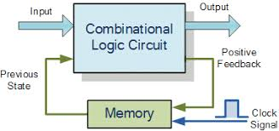

Slide 5
Block diagram of a sequential circuits
The diagram shows a combinational circuits to which memory elements are connected to form a feedback path
The memory elements are devices capable of storing binary information within the system
The binary information stored within the memory elements at any given time defines the state of sequential circuits

Slide 6
sequential circuits receives the binary information from external inputs
These inputs together with the present state of the memory elements determines the binary value at the output terminals
They also determine the condition for changing the state in the memory elements
The block diagram demonstrates that the external outputs in the sequential circuits are a function not only of external inputs but also of the present state of the memory elements

Slide 7
The next state of the memory elements is also a function of external inputs and present state
Thus a sequential circuit is specified by a time sequence of inputs, outputs and internal states

Slide 8
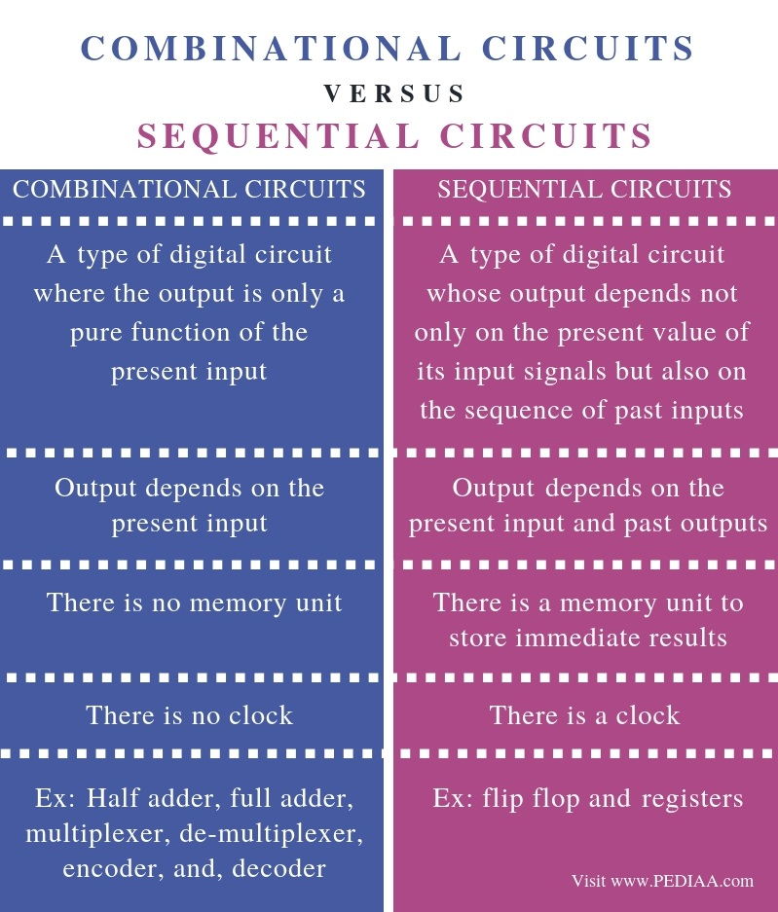

Slide 9
Types of sequential circuits
There are two types of sequential circuits:
There classification depends on the timing of their signals
Synchronous Sequential circuits
Asynchronous Sequential circuits

Slide 10
Synchronous Sequential Circuits
A synchronous sequential circuit is a system whose behavior can be defined from the knowledge of its signals at discrete instants of time.
Synchronous sequential circuit must employ signals that effect the memory elements only at discrete intervals of time.

Slide 11
One way to achieve this goal is to use pulses of limited duration through out the system so that one pulse amplitude represents logic-1 and another pulse amplitude represents logic-0.
The difficulty with the pulses is that any two pulses arriving from separate independent sources to the inputs of the same gate will exhibit unpredictable delays, will separate the pulses slightly and will result in unreliable operation.

Slide 12
Practical synchronous sequential logic systems use fixed amplitude such as voltage levels for the binary signals.
Synchronization is achieved by a timing device called a master clock generator which generates a periodic train of clock pulses.
The clock pulses are distributed throughout the system in such a way that memory elements are effected only with the arrival of the synchronization pulse.

Slide 13
In practice the clock pulses are applied into AND gate together with the signals that specify the required change in memory elements.
The AND gate output can transmit signals only at instants which coincide with the arrival of clock pulses.
Synchronous sequential circuits that use clock pulses in the inputs of the memory elements are called clocked sequential circuits.

Slide 14
Clocked sequential circuits are the type encountered most frequently.
They do not manifest the instability problems and their timing is easily broken down into independent discrete steps each of which is considered separately.
The memory elements used in the clocked sequential circuits are called flip-flops.
These circuits are binary cells capable of storing one bit of information.

Slide 15
A flip-flops circuits are binary cells capable of storing the value of the one bit stored in it.
Binary information can enter a flip-flop in a variety of ways, a fact which gives rise to different types of flip-flops.
A flip-flop circuit can maintain a binary state indefinitely (as long as power is delivered to the circuit) until directed by an input signal to switch state.

Slide 16
The major differences among various types of flip-flops are:
number of inputs they posses.
Manner in which these inputs affect the binary state.

Slide 17
Asynchronous Sequential Circuits
The behavior of Asynchronous Sequential Circuits depends upon the order in which its input signals change and can be effected at any instant of time
The memory elements commonly used in Asynchronous Sequential Circuits are time delay devices

Slide 18
The memory capability of a time delay device is due to the fact that it takes a finite time for the signal to propagate through the device.
In practice the internal propagation delay of logic gates is of sufficient duration to produce the needed delay so that physical time delay units may be unnecessary.
So asynchronous sequential circuit may be regarded as a combinational circuit with feedback.

Slide 19
Because of the feedback among logic gates an asynchronous sequential circuit may at times become unstable.
The instability problem imposes many difficulties on the designer.
That’s why they are not commonly used as synchronous systems.

Slide 20
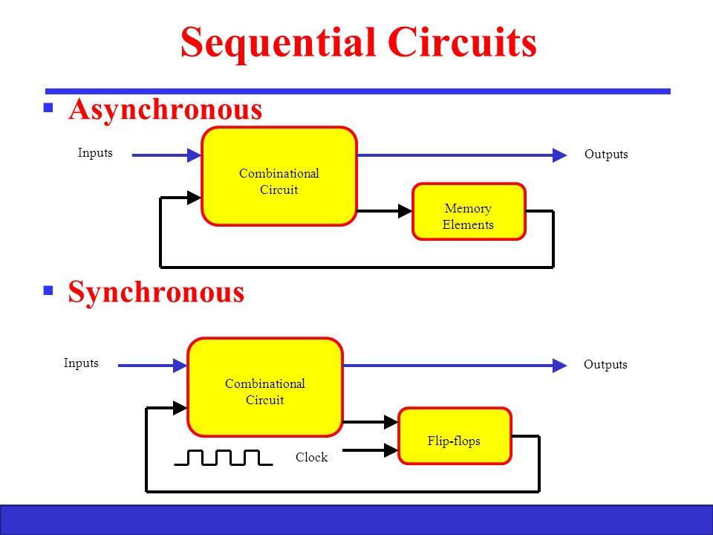

Slide 21
Basic Flip-Flop Circuits
Flip- Flop circuits can be constructed from:
Two NAND gates
Two NOR gates
A flip-flop has two useful states:
When Q=0 and Q’=0, it is in the set state (or 1- state).
When Q=0 and Q’=1, it is clear state (or 0-state).

Slide 22
The outputs Q and Q’ are complements of each other and referred to as the normal and complements outputs, respectively.
The binary state of flip-flop is taken to be the value of the normal output.
Under normal operation, both inputs remain at 0 unless the state of the flip-flop has to be changed.
A momentary 1 applied to the reset input causes the flip-flop to go to clear state.

Slide 23
When both inputs are initially 0, a 1 applied to the set input while the flip-flop is in the set or a 1 applied to the reset input while the flip-flop in the clear state leaves the output unchanged.
When a 1 is applied to both the set and the reset inputs, both outputs go to 0. This state is undefined and is usually avoided.
If both inputs now go to 0, the state of the flip-flop is indeterminate and depends on which input remains a 1 longer before the transition to 0.

Slide 24
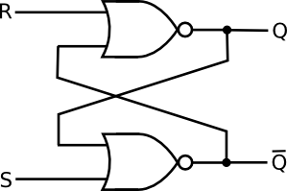
Flip-Flop with NOR gate

Slide 25
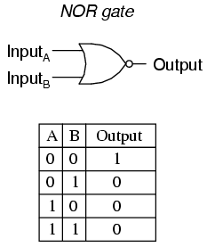

Slide 26
You know that the output of a NOR gate is 0 if any input is 1, and that the output is 1 only when all inputs are 0.
As a starting point, assume that the set input is 1 and the reset input is 0. Since gate 2 has input of 1, its output Q’ must be 0, which puts both inputs of gate 1 at 0, so that the output Q is 1.
When the set input is returned to 0, the outputs remain the same, because output Q remains a 1, leaving one input of gate 2 at 1. That causes output Q’ to stay at 0, which leaves both inputs of gate number 1 at 0, so that output Q is a 1.

Slide 27
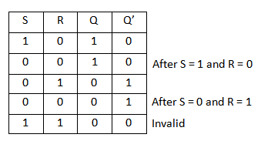

Slide 28
In the same manner it is possible to show that a 1 in the reset input changes the output Q to 0 and Q’ to 1. When the reset input returns to 0, the outputs do not change.
When a 1 is applied to both the set and the reset inputs, both Q and Q’ outputs go to 0. This condition violates the fact that outputs Q and Q’ are the complements of each other. In normal operation this condition must be avoided by making sure that 1’s are not applied to both inputs simultaneously.

Slide 29
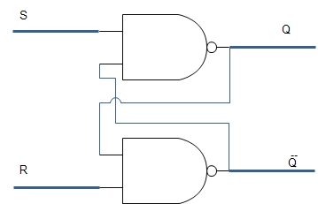
Basic Flip-Flop with NAND gate

Slide 30
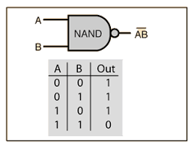

Slide 31
SR flip flop can be designed by cross coupling of two NAND gates.
It is an active low input SR flip – flop.
When both the SET and RESET inputs are high, then the output remains in previous state i.e. it holds the previous data.

Slide 32
When SET input is HIGH and RESET input is LOW, then the flip flop will be in RESET state. Because the low input of NAND gate with R input drives the other NAND gate with 1, as its output is 1. So both the inputs of the NAND gate with S input are 1. This will cause the output of the flip – flop to settle in RESET state.

Slide 33
When SET input is LOW and RESET input is HIGH, then the flip flop will be in SET state. Because the low input of NAND gate with S input drives the other NAND gate with 1, as its output is 1. So both the inputs of the NAND gate with R input are 1. This will cause the output of the flip – flop to settle in SET state.

Slide 34
When both the SET and RESET inputs are low, then the flip flop will be in undefined state. Because the low inputs of S and R, violates the rule of flip – flop that the outputs should compliment to each other. So the flip flop is in undefined state (or forbidden state).
The table below summarizes above explained working of SR Flip Flop designed with the help of a NAND gates

Slide 35
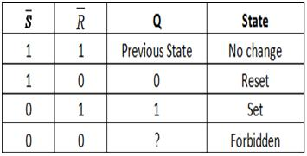

Slide 36
Clocked SR Flip – Flops
Two types of clocked SR flip – flops are possible:
based on NOR.
based on NAND

Slide 37
Clocked SR Flip – Flops using NAND Gate
This is formed by adding two NAND gates to NAND based SR flip – flop.
The inputs are active high as the extra NAND gate inverts the inputs.
A clock pulse is given as input to both the extra NAND gates.
Hence the transition of the clock pulse is a key factor in functioning if this device.

Slide 38
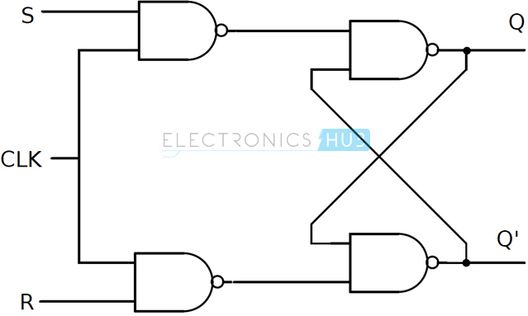
The circuit of clocked SR flip – flop using NAND gates is shown below.

Slide 39
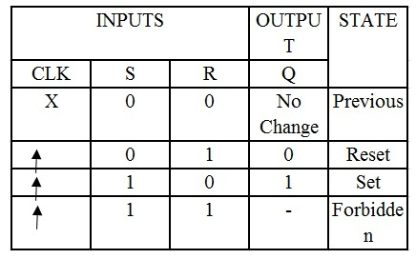

Slide 40
Clocked RS Flip-Flops using NOR gate
The same can be achieved by using NOR gates.
The circuit of clocked SR flip – flop using NOR gates is shown below.
The figure suggests a structure of RS flip – flop (as R is associated to the output Q), the functionality of SET and RESET remain the same i.e. when S is high, Q is set to 1 and when R is high, Q is reset to 0.

Slide 41
